Slide 1




Training Camp for FLL Mentors
Welcome!
Notes:
8:00-8:15

Slide 2
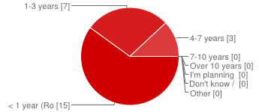
Hello and Welcome!
Thank you for being here!
What will we learn?
To build successful FLL teams.
To have fun & experience what an FLL team is like.
100% Experienced
Notes:
8:15

Slide 3
Agenda
8:15 – 8:30 Getting to Know the EV3
8:30 – 9:45 Build and Program a Robot
9:45 – 10:15 Hands-On Core Values
10:15– 11:00 Advanced Programming, Off-Brick
11:00 – Noon Team Challenges
Noon – 12:30 Lunch
12:30 – 1:30 Presentation & Competition Skills
1:30 – 2:00 The Sendoff

Slide 4
Parts of a Robot
What is the EV3 building system and how has it changed from the earlier NXT?
Controller (The new EV3)
Sensors (New and improved sensors)
Motion (More powerful motors and more parts)
Logic (New programming language)
Notes:
Most of this was pulled from the Boy Scout Robotics Merit Badge handbook.

Slide 5
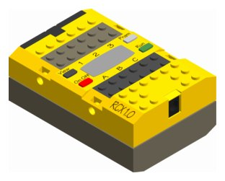
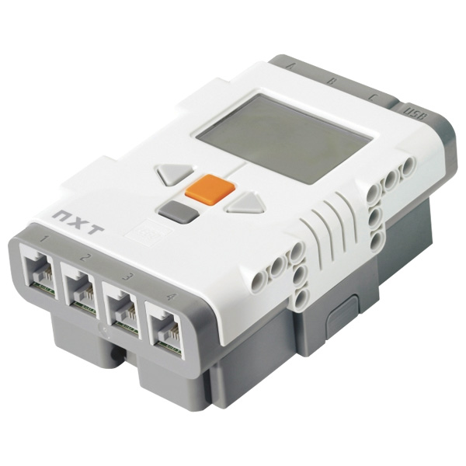
Controller: Years’ Past
LEGO RCX
  Small motors, limited sensors
  Very basic kit
LEGO NXT
  More powerful motors, better sensors
  More powerful and capable brick
  Rapid growth in education

Slide 6
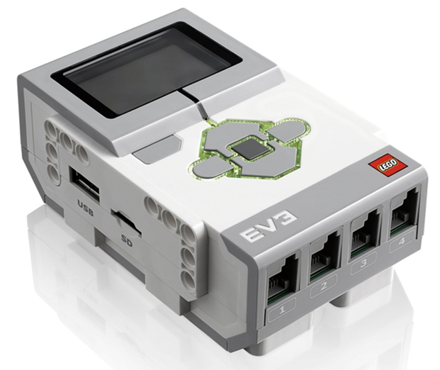
Controller: The EV3
EV3 Intelligent Brick
  Large pixel display
  Backlit 4 Directional + Enter and Back Buttons
  4 Motor (Output) Ports [A, B, C, D]
  4 Sensor (Input) Ports [1 ,2, 3, 4]
  Internal Bluetooth
  SD Card slot
  Two USB ports
    Host port (side): Wifi, camera, etc.
    Computer port (top)
  Batteries
    7.4V Rechargeable OR 9V AA
Notes:
Coaches are to get out the EV3 now
Changes from the NXT to the EV3 are highlighted
Use of host port, in most instances, is disallowed by FLL.

Slide 7
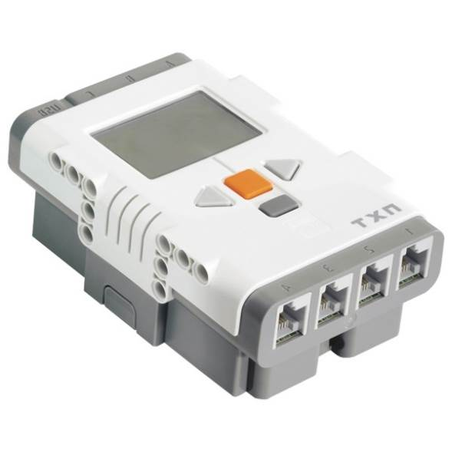
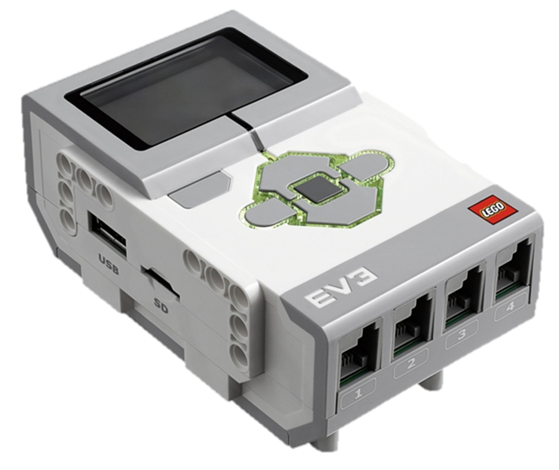
Controller: The EV3
Comparison with NXT
  Much larger display
  Directional buttons
  Status light
  Additional motor port
  More storage and SD slot
    Extra memory for more programs
While FLL still allows the RCX
and NXT, the new EV3 is preferable.

Slide 8
Sensors
The input for the EV3, how the robot sees the world
Touch Sensor
Light Sensor
Ultrasonic Sensor
Gyro Sensor [new in FLL!]

Slide 9
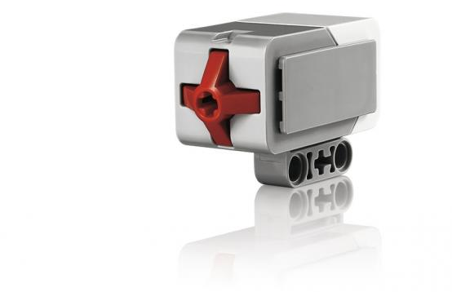
Touch Sensor
Detects whether the red area is pressed
ON if pressed, OFF if not pressed
Nearly identical to the NXT version

Slide 10
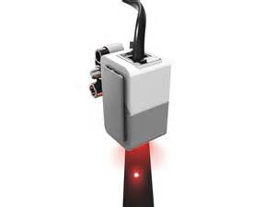
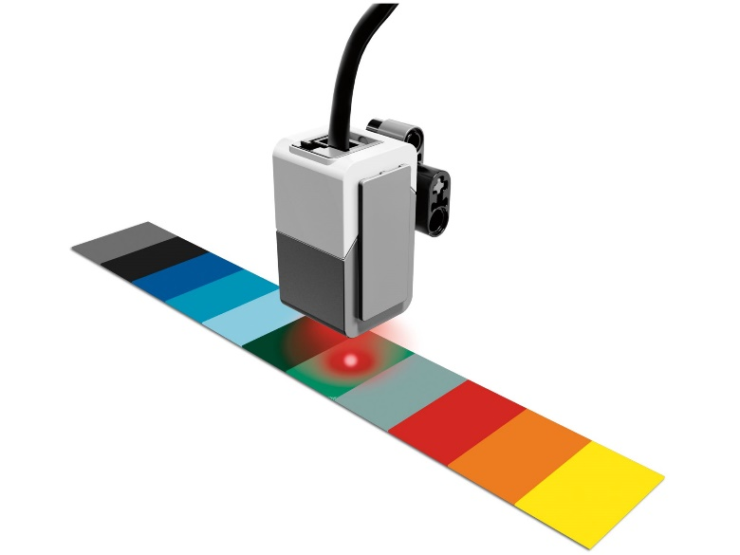
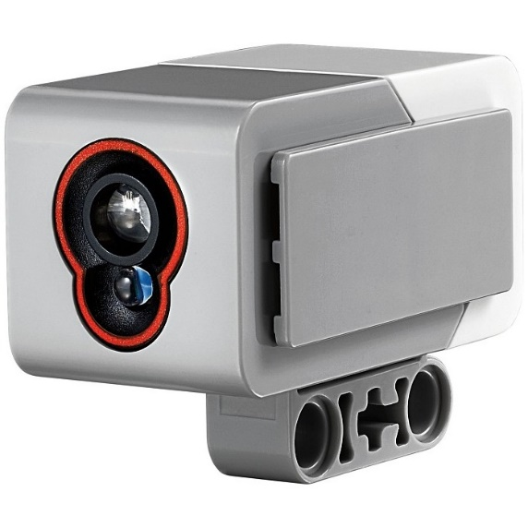
Light Sensor
Detects brightness and color
Three Modes
  Ambient Light (how bright the room is)
  Reflected Light (how white a spot is)
  Color (Red, Green, Blue, and combinations)

Slide 11
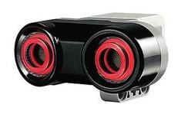
Ultrasonic Sensor
Detects distance from an object
Three Modes
  Distance in centimeters (0 – 255cm)
  Distance in inches (0 – 255in)
  Proximity detection
    Senses if another ultrasonic sensor is nearby
Accuracy
  Accurate between 10 and 100 cm
  Improved detection at close range

Slide 12
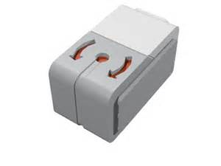
Gyro Sensor
Detects current direction and rotation speed
New sensor in FLL
Two Modes
  Direction from Start (degrees)
  Change in direction (deg/sec)

Slide 13
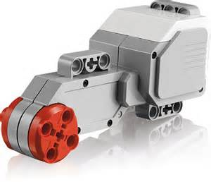
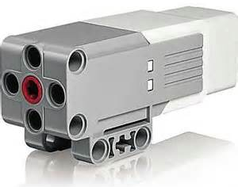
Motion with Motors
EV3 Allows for 4 motor ports (NXT: 3)
Large Motor
  Powerful motor used mainly for driving
  Two large motors in the kit
Medium Motor
  Smaller motor used for arms, grabbers, etc.
  New motor type
  One in each kit

Slide 14
Logic
New EV3 programming environment, X3
  LEGO Mindstorms EV3 Software for Computer
Also allows for on-brick programming

Slide 15
Chassis
The base of the robot, holds all components in
We will be building “Simple Bot”
  Goal: demonstrate new EV3 techniques

Slide 16
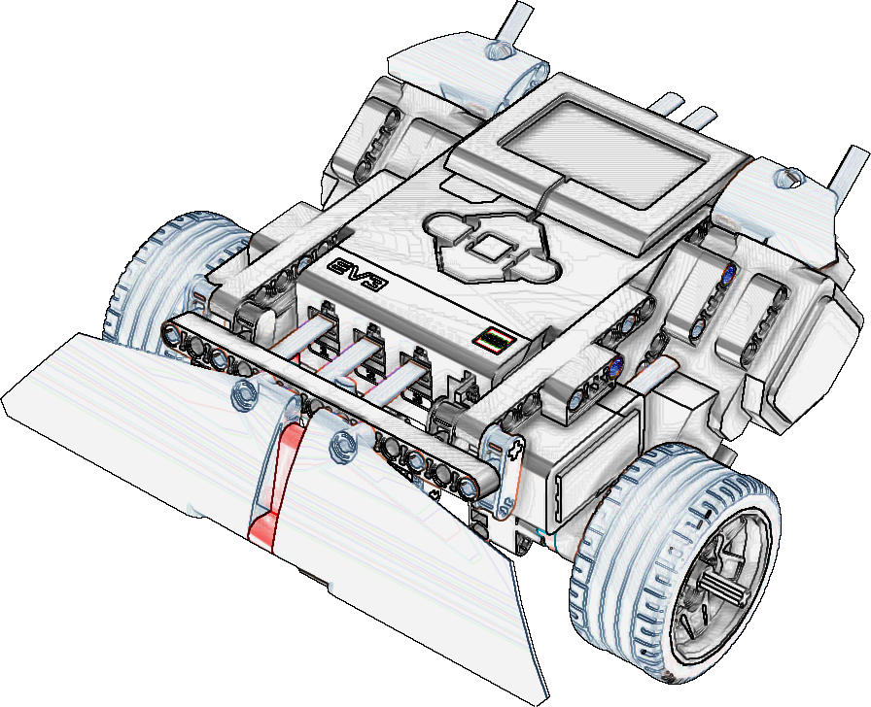
Build Simple Bot
Build in your groups and ask questions!
Time limit: 45 minutes
Notes:
8:00-8:15

Slide 17
Getting to Know the EV3
Turning the Power On/Off
  Open your kits and find the rechargeable battery pack
  Insert the rechargeable battery into the back of the EV3, hand us the EV3 battery covers
  Turn the brick on by pressing the gray (ENTER) button
    Brick will take 30 seconds to start up...

Slide 18
Getting to Know the EV3
What’s On the Display
Running a recent program
Running a program in Folder View
Making the Brick Less Annoying (turning down the volume)

Slide 19
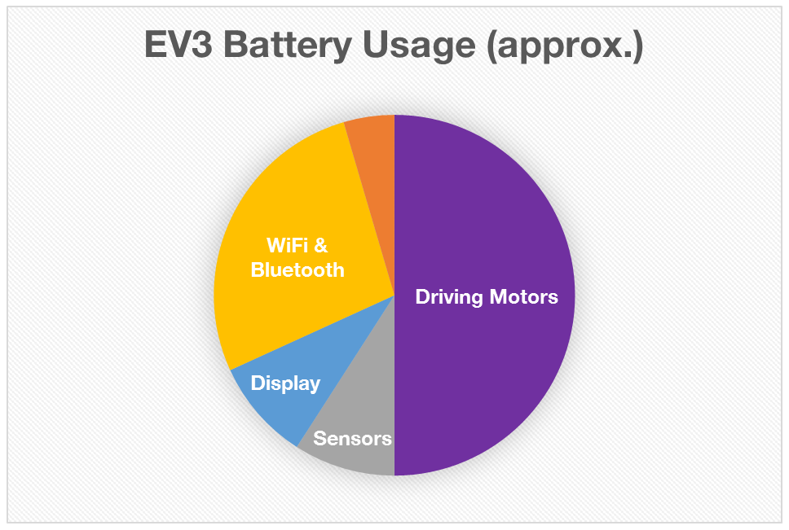
Getting to Know the EV3
Conserving Some Battery (turning off Bluetooth)

Slide 20
Getting to Know the EV3
Reading Sensors Using Sensor Viewer
Test the Touch Sensor
Test the Light Sensor
Test the Gyro Sensor
Test Large Motors
Test Medium Motor (attach to port D)
Test Ultrasonic Sensor (attach to port 4)
When done, disconnect ports 4 and D.

Slide 21
On-Brick Programming
Opening the Program Editor
On-Brick Programming Basics
  What’s on the screen
  How to navigate the menus

Slide 22
On-Brick Programming
Writing a Move Program
  Move the motors forward for 2 seconds then turn around and move back

Slide 23
On-Brick Programming
Writing a Bumper Program
  Move the motors forward until the robot bumps into something, then turn around and repeat

Slide 24
On-Brick Programming
Challenge: The Smiling Bot (Time limit: 5 minutes)
  While the robot is moving, display a picture to the screen
  When it is turning around, change the face and make a sound
  Use the display block (looks like two pictures) and a sound block (looks like a speaker)

Slide 25
Core Values Exercises
Notes:
8:00-8:15

Slide 26

Off-Brick Programming
Codename “X3”
  LEGO Mindstorms for EV3 Software
  Name originally used internally to refer to the EV3 software
Start by opening X3
Notes:
X3 Menus
Creating a new project
What’s on the screen
The Block Menus
Close the content editor – get ready to program!

Slide 27
Off-Brick Programming
X3 Menus
Creating a new project
What’s on the screen
Close the content editor – get ready to program!

Slide 28
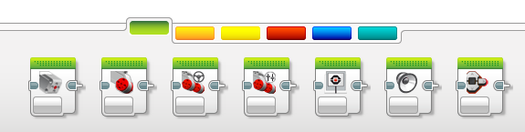
Off-Brick Programming
Block Menus
Motion
Flow
Sensors
Data / Math
Advanced
My Blocks

Slide 29

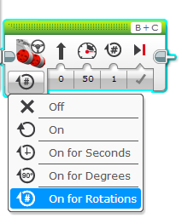
First Block
Move Motors (Steering)
Motion
Ports
Wire IN
Wire OUT
Parameters
Mode

Slide 30
Off-Brick Programming
Writing a Move Program
  Move the motors forward for 2 seconds then turn around and move back
Motion
Notes:
First, double click the name of the program in the title bar and rename it “Simple Bot”
Select Actions (Green) > Drag Move Steering next to play button
Drop and set power to 100
Add wait block (Flow – Orange)
Set wait for touch sensor
Set state to pressed (1)
Add another Move Steering block (Green) and set power to -100 and steering to 50 (match picture from EV3 On-Brick)
Running the program
Connect brick via USB to “PC” port next to motor ports
Turn on brick
Lower-Right of screen: EV3 Control Panel
Select Circle “Play” button to Download and Run
Download Icon
Download and Run
Run Selected
What’s Wrong?
Before touch, motors stop too soon
Set mode of 1st move block to “On” (forever)
Program only runs once
Drag loop (orange) after play block
Highlight three following blocks
Drag three blocks into loop
Stop Program
Press back button on EV3 or Press Stop button on EV3 Control Panel

Slide 31

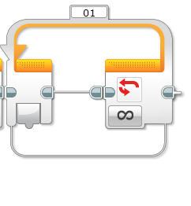
New Block
Loop
Flow
Name of loop
Blocks go here!
Times Looped So Far
Loop For How Long?

Slide 32
Off-Brick Programming
Improve the Move Program
  Put everything in a loop
Motion
Flow

Slide 33

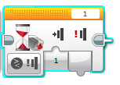

New Block
Wait Block
Flow
Is the touch sensor pressed?
Has the touch sensor state changed?
Inputs
(Wire fits in)
Outputs
(Wire comes out)

Slide 34
Off-Brick Programming
Writing a Bumper Program
  Move the motors forward until the robot bumps into something, then turn around and repeat
Motion
Flow
Sensors

Slide 35


Off-Brick Programming
Challenge: The Smiling Bot (Time limit: 5 minutes)
  While the robot is moving, display a picture to the screen
  When it is turning around, change the face and make a sound
  Same as on-brick, try it off-brick now!
Display Block
Motion
Sound Block
Motion

Slide 36

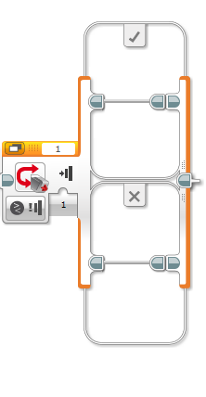
New Block
Switch
Flow
True Case
“If touch sensor pressed, do this.”
Condition
“If touch sensor pressed”
False Case
“If touch sensor is NOT pressed, do this.”

Slide 37
Off-Brick Programming
Activity: Squared
  Make the robot move around in a square
  When it bumps into something, just stop and wait until nothing is touching, then continue
Flow

Slide 38
Data Types
Boolean
  TRUE or FALSE?
  A touch sensor is a boolean
Integer
  A number
  An ultrasonic sensor is an integer
String
  A line of characters and words
  Example: “Hello World!”
Color of Wires
Color of Wires
Color of Wires

Slide 39
Sensor Programming
What does it measure? What data type is this?
Touch Sensor
Light Sensor
Ultrasonic Sensor
Gyro Sensor
Motor Rotation Sensor
Boolean
Integer
Integer
Integer
Integer

Slide 40
Sensor Challenges
Touch Sensor
Activity 1: Read the intensity of the reflected light to the screen, display a “%” sign after text
Challenge 2: Read the intensity of the ambient light to the screen, display a “%” sign after text
Challenge 3: Make button status light turn green when the color blue is found, red otherwise
Challenge 3.1: Make it shout “BLUE!” instead (use sound block)

Slide 41
Sensor Challenges
Gyro Sensor
Challenge 1: Change status light to green if you are moving, red otherwise
Challenge 2: Change status light to red if you’re moving faster than 200 degrees/second, green otherwise
Challenge 3: Challenge 3, except wait 50 msec before checking again (hint: use the “wait” block).

Slide 42
Sensor Challenges
Motor Rotation Sensor
Challenge 1: Display the current rotation to the screen in degrees
Challenge 2: Move motors for 5 rotations, no loop required
Challenge 2.1: Display to the screen how many seconds it takes to move 5 rotations at 100% power (have a wait for EV3 button press at the end)

Slide 43
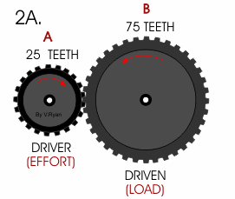
Motion with Gears – Basics
How many times faster is gear
A turned than gear B?
Look at the junction between the gears!
When gear B makes one rotation,
it moves 75 teeth through the junction.
So gear A must move 75 teeth through the same junction.

Slide 44
Motion with Gears – Basics
How many times faster is gear
A turned than gear B?
Gear B moves 75 teeth in one rotation
Gear A moves 75 teeth in the same time
Gear A only has 25 teeth
75 teeth/time / 25 teeth = 3 times faster
Gear A must be moving three times faster than gear B

Slide 45
Motion with Gears – Gear Ratios
Gear Ratio = Input T / Output T
What is the gear ratio?
75 teeth / 25 teeth = 3
Ratio = 3 Output : 1 Input
For every 1 revolution of motor,
Gear train will move 3 revolutions

Slide 46
Motion with Gears – Gear Ratios
Gear B is turned at 3 revolutions/min. How many revolutions has Gear A turned?
First, calculate gear ratio: 125/50 = 5:2 or 2.5
Multiply by revolutions of B to get A: 125/50 * 3 rev/min = 7.5 rev/min
125 TEETH
50 TEETH

Slide 47
Motion with Gears – Torque and Speed
Why is this important?
  Gear ratios determine torque and speed
Torque = rotational force
  Higher torque = more “lifting strength”
The higher the ratio, the more speed you get
  Great if you want a robot that moves fast
The lower the ratio, the more torque you get
  Great if you want an arm that can lift lots of things
Notes:
Bring in R1D2
If we want a super-fast fan, would we want more torque or speed?
Answer: speed, this is about a 78:1 gear train

Slide 48
Motion with Gears – The Rule
Bigger gear to smaller gear = more speed
Smaller gear to bigger gear = more torque

Slide 49
Motion with Gears – Another Reason
EV3 Motors, as any, have a problem… (something that MANY FLL teams miss)
Every motor takes in a voltage and creates torque, which moves wheels
There is NO TRUE “speed control” on the EV3, only voltage
  Low voltage to motor = low torque
  High voltage to motor = high torque

Slide 50
What does this mean for FLL?
Running motors at full speed provides most reliable operation
But it’s also hard to move at 100% speed on a small field
To slow down a robot, you have to lower the voltage
  Lower torque = greater ability to slide
  Robots will not move reliably on different surfaces
How do we get around this?
  GEAR down motors to increase torque
  Always run the robot at 80-100% speed (if geared)
  Fast is NOT always better

Slide 51
Experiment
Find a rotation time (on a single surface at 100% speed) such that the robot rotates about 180 degrees.
Start with 100% speed, then lower by 10% each time until at 10%
Run 3 trials for each speed (each on different surfaces), record the angle difference of the gyro and find the range (maximum trial – minimum trial)
The greater the range, the greater the inaccuracy
At home: Try gearing motors for torque and try again!
  What could be the results?

Slide 52
Runaway Robot
Time limit: 10 minutes
Challenge 1: Keep moving forward until the touch sensor is pressed, then turn around and continue on!
Challenge 2: Physically attach an ultrasonic sensor so that it can see a wall in front of it.
Challenge 3: Do the same as challenge 1, but turn around when the ultrasonic sensor detects anything within 25 cm

Slide 53
Sumo Bowling Bots
Time limit: 25 minutes
Challenge: A robot is placed into a “ring” surrounded by tape, with 12 Jenga pieces (upright) scattered on floor and a small tower of Jenga pieces in the center
Goal: Knock down as many pieces as possible in 30 seconds
Points: 1 point for 1 block out at one time, 2 points per block for 2 blocks out at a time, etc.
Rules: If your robot completely leaves the ring for more than 5 seconds, you gain no points

Slide 54
Race Car Robot
Time limit: 30 minutes
Challenge: Follow a “racetrack” path on the floor using a light sensor.
Goal: This one is hard to crack! Fastest racer wins!

Slide 55
Capture the Flag
Time limit: 25 minutes
Challenge: Two robots are placed onto a board with three rings on the opposite side of each robot and a pipe in the center of the field.
Goal: Grab all three of the opponent’s rings and return to your starting spot!
Points: 50 points per ring, 100 points for moving pipe outside of playing field
Timing: Each match will last up to 60 seconds

Slide 56
RoboRally
Challenge: Each team will be handed 5 cards. The card contains a number, in either rotations OR seconds (I will tell you) and a direction. The goal is to make your robot follow the cards’ instructions.
Every few rounds, I will give you one additional card per round with the same time limit.
If you receive a blue card, you MUST follow the directions on it for the next round (return these to me after that round is over).

Slide 57
The Sendoff
Notes:
8:00-8:15

Slide 58
The Sendoff
We will send you an email within a few days with a link to this presentation and the building instructions
What have you learned?
Survey
Peer Advice

Slide 59
Thank you!
Notes:
8:00-8:15

